Slide 1
Lecture 28

Slide 2
Thermodynamics

Slide 3
Question 123.7.4
If two samples of matter are measured to be at the same temperature, what can we say about them.
They must be the same material
They must be the same state of matter
They must be the same phase
They must be in thermal equilibrium

Slide 4
Thermal Contact Defined
A
B

Slide 5
Thermal Contact Defined
A
B

Slide 6
Question 123.8.1
About how big is an atom?

Slide 7
Question 123.8.2
About how many atoms (rough order of magnitude) are in a typical sample of material?

Slide 8
Question 123.8.2.5
Suppose we have 25 students in a room of volume 100m³. What would we call the quantity 25/100m³?
Crowding factor
Number density
Dating opportunity factor
Population

Slide 9
Question 123.8.3
What is a number density?
How compact numbers in a particular domain. For example, real numbers are infinitely dense
The number of something in a unit of volume
The quantity of undatable people in your FHE group
A measure of total mass of an object

Slide 10
Question 123.8.4
If I have 1000 hydrogen atoms in a 1 liter volume, what is my number density?

Slide 11

Question 123.8.5
What is the atomic weight of ?
6u
12u
14u
13.567u
$${}_{6}^{12}C$$

Slide 12
Question 123.8.6
If I have a dozen eggs, how many eggs do I have?
6
12
13
24

Slide 13
Question 123.8.7
If I have a mole of eggs, how many eggs do I have?
6.02 x 10²³
12
1000
1.0 x 10⁸

Slide 14
Question 123.8.8
If I have 24 eggs, how many dozens of eggs do I have?
1
2
3
4

Slide 15
Question 123.8.9
If I have 1.24 x 10²⁴ eggs, how many moles of eggs do I have?
1
2
3
4

Slide 16
Question 123.8.10
Oxygen has an atomic mass of about 16u, what is the molar mass of O₂?
8g/mol
16 g/mol
32 g/mol
64 g/mol

Slide 17
Question 123.8.10.2
What might be the problem with calibrating your Celsius scale thermometer here in Rexburg, ID?
No problem, the Celsius scale is well established
Because it is so cold here, you might drop the thermometer while you work on it.
Water does not boil at 100 °C here
The scale does not work well for temperatures outside the 0 °C to 100 °C range.

Slide 18
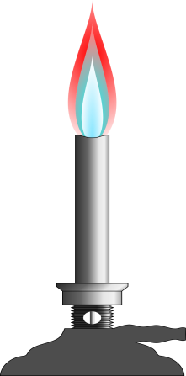
100°C
0°C

Slide 19
Temperature from the Zeroth Law
Two objects in thermal equilibrium with each other are at the same temperature
Temperature is the property that determines whether or not an object is in thermal equilibrium with other objects

Slide 20
Question 123.8.10.3
The pressure in a constant-volume gas thermometer extrapolates to zero at what temperature?
0°C
0 K
0°F
0 Pa

Slide 21
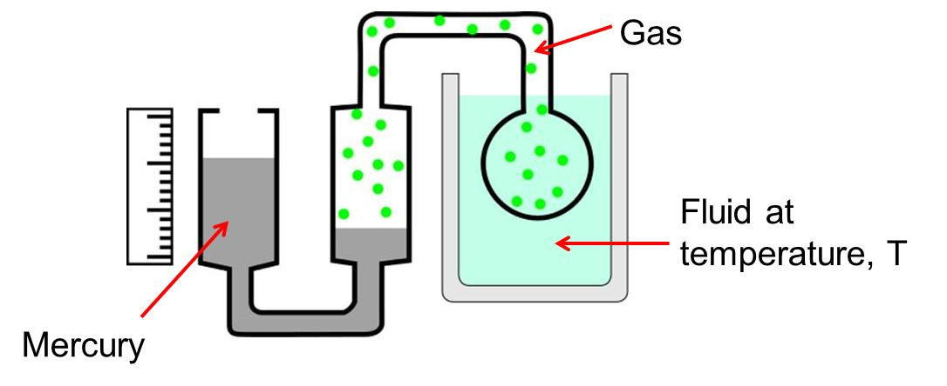
Question 123.8.10.4
We have a complicated gadget as shown. At points C and D
The pressure is the same
The pressure at point D is larger
The pressure at point C is larger
You can’t tell unless you know the pressure of the gas
C
D

Slide 22
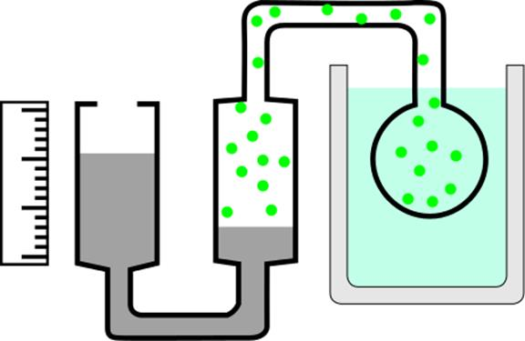
Gas
A
Fluid at temperature, T
B
Mercury

Slide 23
P (Pa)
Temperature (°C)
-200
-100
0
100

Slide 24
P (Pa)
P = 0 Pa
T = -273 °C
Temperature (°C)
-200
-100
0
100

Slide 25
P (Pa)
P = 0 Pa
T = 0 K
Temperature (°C)
-200
-100
0
100

Slide 26
10⁹
10⁸
10⁷
Solar Interior
10⁶
10⁵
10⁴
Solar “surface”
10³
Copper Melting Point
10²
Water Freezes
Liquid Nitrogen
10
1
Liquid Helium

Slide 27
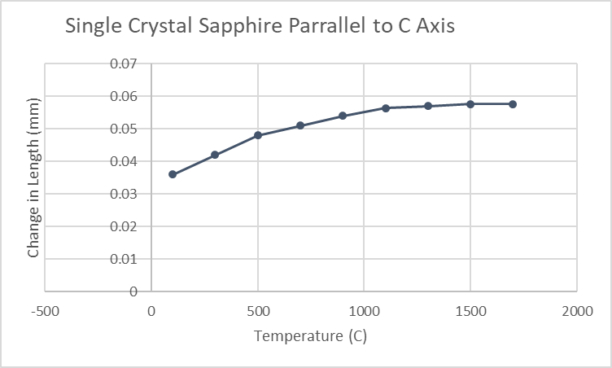

Slide 28
Material | Average α(K⁻¹)
Aluminum | 25×10⁻⁶
Copper | 17×10⁻⁶
Gold | 14×10⁻⁶
Lead | 29×10⁻⁶
Brass | 18.7×10⁻⁶
Steel | 11×10⁻⁶
Glass | 9×10⁻⁶
Concrete | 12×10⁻⁶

Slide 29
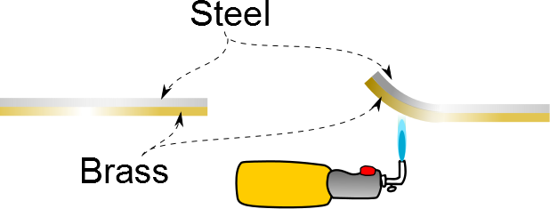

Slide 30
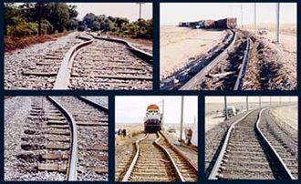

Slide 31
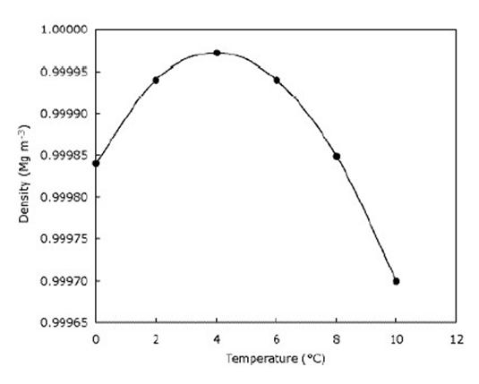

Slide 33
END

